Slide 1
TDD

Slide 2
WTF?
Test Driven Development - is a software development process that relies on the repetition of a very short development cycle:
first the developer writes a failing automated test case that defines a desired improvement or new function
then produces code to pass that test
and finally refactors the new code to acceptable standards.

Slide 3
Why?
More robust code
Forces developer to design from an interface
Better design of program
Discipline
Show how to work with code

Slide 4
Example
The simplest example is using assertions in java:
1. First write a test:
Summator summator = new Summator();
int sum = summator.sum(5, 0);
Assert.equals(sum, 5);
2. Then write a code:
public class Summator {
public int sum(int x, int y) {
return x + y;
}
}

Slide 5
JUnit
JUnit is a simple framework to write repeatable tests
Set up JUnit support in IDE
Write test for your module
Run test – make sure it fails
Implement you module
Run test – make sure it passes

Slide 6
Set up JUnit in Eclipse
1. Right click on project -> select properties in context menu
2. Select Java Build Path
3. Select Libraries tab
4. Press the Add Library… button
5. Select JUnit from the list, press Next
6. Select JUnit 4, press Finish

Slide 7
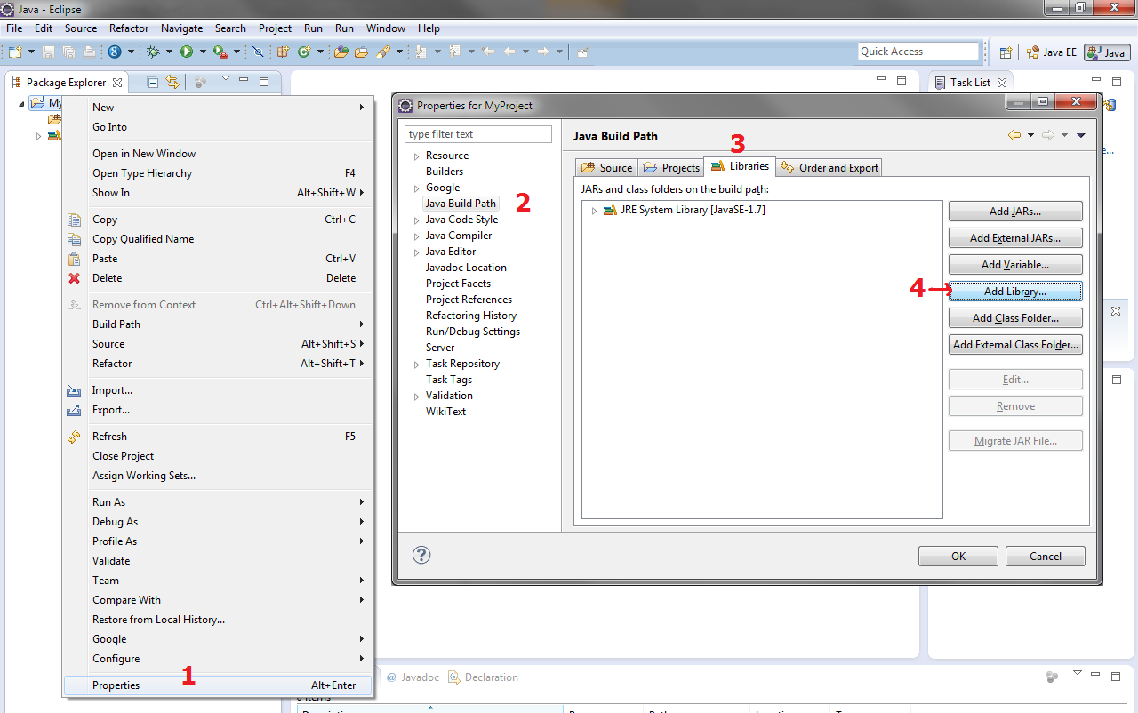

Slide 8
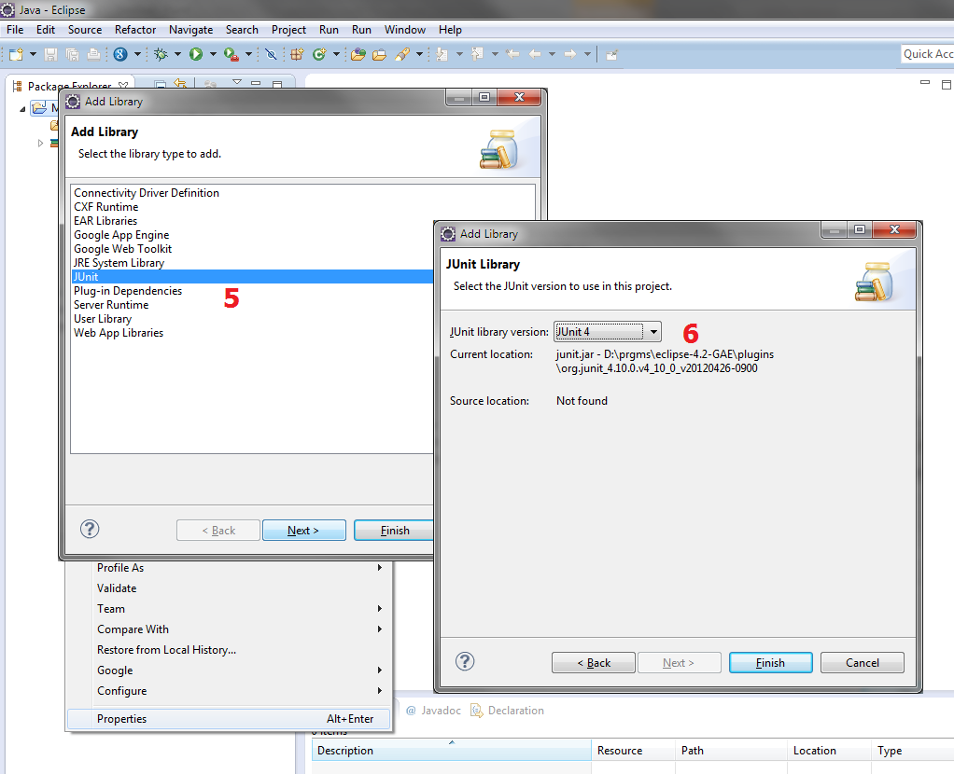

Slide 9
Write your test
Test is a java class with special attributes
Name of the test class matches the name of tested class + “Test” suffix (SummatorTest)
Methods in test class start with “test” prefix + name of tested method (testAdd).
Each method (usually) contains logic to test one method of tested class

Slide 10
Test Class Example
class SummatorTest {
@Test
public void testSum() {
Summator summator = new Summator();
int sum = summator.sum(2, 3);
Assert.assertEquals(5, sum);
}
}

Slide 11
Running the Test
Right click on Test Class
Select Run As -> JUnit Test

Slide 12
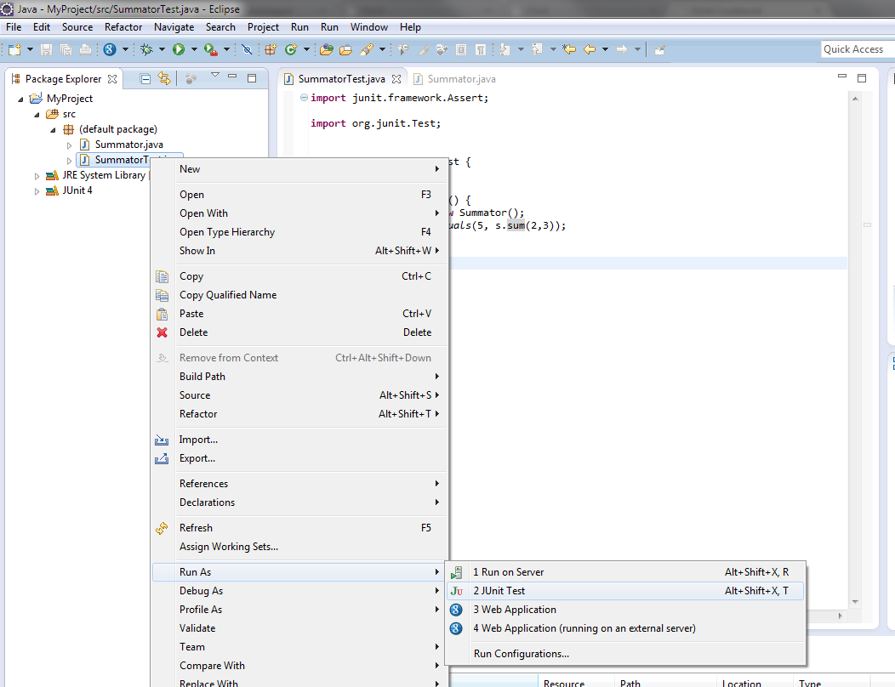

Slide 13
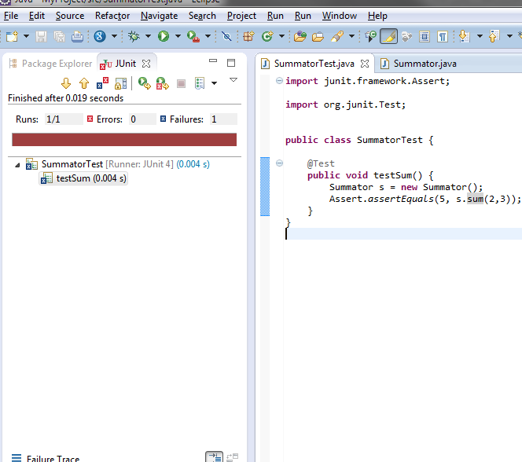

Slide 14
More
See JUnit

